Slide 1
Database Concepts and Technologies
Rev K.O. PEASAH(Pierro)

Slide 2
Course Administration
Lectures
Labs
Assignments/Quizes
Mid Semester Examination
Text Book:1. Fundamentals of Database Systems: 5th Edition by Elmasri/Navathe
2. Database Systems: 4th Edition by Connolly/Begg

Slide 3
Lecture 1
Introduction To Databases

Slide 4
Outline
Types of Databases and Database Applications
Characteristics of file-based systems.
Problems with file-based approach.
Basic Definitions
Typical DBMS Functionality
Example of a Database (UNIVERSITY)
Main Characteristics of the Database Approach
Advantages of Using the Database Approach
History of Databases

Slide 5
Types of Databases and Database Applications
Traditional Applications:
  Numeric and Textual Databases
More Recent Applications:
  Multimedia Databases
  Geographic Information Systems (GIS)
  Data Warehouses
  Real-time and Active Databases
  Many other applications

Slide 6
File-Based Systems
One way to keep information on a computer is to store it in permanent files.
A company system has a number of application programs; each of them is designed to manipulate data files.
These application programs have been written at the request of the users in the organization.
New applications are added to the system as the need arises.

Slide 7
File-Based Systems
The system just described is called the file-based system.
Collection of application programs that perform services for the end users (e.g. reports).
In traditional file processing, each user defines and implements the files needed for a specific software application as part of programming the application
Each program defines and manages its own data.

Slide 8
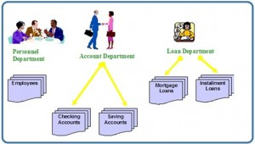

Slide 9
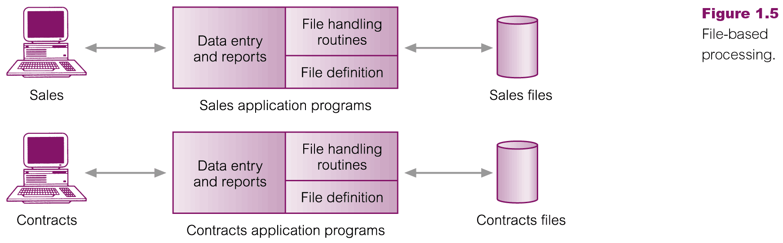
File-Based Processing

Slide 10
LIMITATIONS/DISADVANTAGES OF THE FILE-BASED APPROACH

Slide 11
1. Separation Isolation of Data cont’d
Separation and isolation of data
  Each program maintains its own set of data.
  Users of one program may be unaware of potentially useful data held by other programs.
Data are scattered in various files, and the files may be in different format, writing new application program to retrieve data is difficult

Slide 12
Separation Isolation of Data
Data isolation is a property that determines when and how changes made by one operation become visible to other concurrent users and systems.
This issue occurs in a concurrency situation.
  This is a problem because:
    It is difficult for new applications to retrieve the appropriate data, which might be stored in various files.

Slide 13
2. Duplication of Data
Duplication of data
  Same data is held by different programs.
  Wasted space and potentially different values and/or different formats for the same item.

Slide 14
3. INTEGRITY PROBLEMS
It refers to the maintenance and assurance that the data in a database are correct and consistent. Factors to consider when addressing this issue are:
  Data values must satisfy certain consistency constraints that are specified in the application programs.
    It is difficult to make changes to the application programs in order to enforce new constraints

Slide 15
4. CONCURRENCY ACCESS
Concurrency is the ability of the database to allow multiple users access to the same record without adversely affecting transaction processing.
A file-based system must manage, or prevent, concurrency by the application programs.

Slide 16
CONCURRENCY ACCESS CONT’D
Typically, in a file-based system, when an application opens a file, that file is locked. This means that no one else has access to the file at the same time.
In database systems, concurrency is managed thus allowing multiple users access to the same record.
This is an important difference between database and file-based systems.

Slide 17
6. SECURITY PROBLEMS
Security can be a problem with a file-based approach because:
There are constraints regarding accessing privileges.
Application requirements are added to the system in an ad-hoc manner so it is difficult to enforce constraints.

Slide 18
7. DIFFICULT IN ACCESSING DATA
It is not easy to retrieve information using a conventional file processing system.
Convenient and efficient information retrieval is almost impossible using conventional file processing system.

Slide 19
Other Limitations of File-Based
8. Data dependence
  File structure is defined in the program code.
9. Incompatible file formats
  Programs are written in different languages, and so cannot easily access each other’s files.
10. Fixed Queries/Proliferation of application
programs
  Programs are written to satisfy particular functions.
  Any new requirement needs a new program.

Slide 20
Observations and Conclusions
Data Redundancy may leads to Data inconsistency , if redundant data are not updated simultaneously. Data inconsistency leads the system into an inconsistent state, since the operations based on inconsistent data results in to more inconsistency.

Slide 21
Database Approach
Arose because:
  Definition of data was embedded in application programs, rather than being stored separately and independently.
  No control over access and manipulation of data beyond that imposed by application programs.
Result:
  the database and Database Management System (DBMS).

Slide 22
Basic Definitions
Database:
  A collection of related data.
Data:
  Known facts that can be recorded and have an implicit meaning.
Mini-world:
  Some part of the real world about which data is stored in a database. For example, student grades and transcripts at a university.
Database Management System (DBMS):
  A software package/ system to facilitate the creation and maintenance of a computerized database.
Database System:
  The DBMS software together with the data itself. Sometimes, the applications are also included.

Slide 23
Restrictive:
A database is a persistent, logically coherent collection of inherently meaningful data, relevant to some aspects of the real world.
A database management system (DBMS) is a collection of programs that enables users to create and maintain a database. According to the ANSI/SPARC DBMS Report (1977), a DBMS should be envisioned as a multi-layered system:

Slide 24



Slide 25

Simplified database system environment

Slide 26
Typical DBMS Functionality
Define a particular database in terms of its data types, structures, and constraints
Construct or Load the initial database contents on a secondary storage medium
Manipulating the database:
  Retrieval: Querying, generating reports
  Modification: Insertions, deletions and updates to its content
  Accessing the database through Web applications
Processing and Sharing by a set of concurrent users and application programs – yet, keeping all data valid and consistent

Slide 27
Typical DBMS Functionality
Other features:
  Protection or Security measures to prevent unauthorized access
  “Active” processing to take internal actions on data
  Presentation and Visualization of data
  Maintaining the database and associated programs over the lifetime of the database application
    Called database, software, and system maintenance

Slide 28
Example of a Database
(with a Conceptual Data Model)
Mini-world for the example:
  Part of a UNIVERSITY environment.
Some mini-world entities:
  STUDENTs
  COURSEs
  SECTIONs (of COURSEs)
  (academic) DEPARTMENTs
  INSTRUCTORs

Slide 29
Example of a Database
(with a Conceptual Data Model)
Some mini-world relationships:
  SECTIONs are of specific COURSEs
  STUDENTs take SECTIONs
  COURSEs have prerequisite COURSEs
  INSTRUCTORs teach SECTIONs
  COURSEs are offered by DEPARTMENTs
  STUDENTs major in DEPARTMENTs

Slide 30

Example of a simple database

Slide 31
Main Characteristics of the Database Approach
Self-describing nature of a database system:
  A DBMS catalog stores the description of a particular database (e.g. data structures, types, and constraints)
  The description is called meta-data.
  This allows the DBMS software to work with different database applications.
Insulation between programs and data:
  Called program-data independence.
  Allows changing data structures and storage organization without having to change the DBMS access programs.

Slide 32

Example of a simplified database catalog

Slide 33
Main Characteristics of the Database Approach (continued)
Data Abstraction:
  A data model is used to hide storage details and present the users with a conceptual view of the database.
  Programs refer to the data model constructs rather than data storage details
Support of multiple views of the data:
  Each user may see a different view of the database, which describes only the data of interest to that user.

Slide 34
Main Characteristics of the Database Approach (continued)
Sharing of data and multi-user transaction processing:
  Allowing a set of concurrent users to retrieve from and to update the database.
  Concurrency control within the DBMS guarantees that each transaction is correctly executed or aborted
  Recovery subsystem ensures each completed transaction has its effect permanently recorded in the database
  OLTP (Online Transaction Processing) is a major part of database applications. This allows hundreds of concurrent transactions to execute per second.

Slide 35
What Does a DBMS Do?
Database management systems provide several functions in addition to simple file management:
allow concurrency
control security
maintain data integrity
provide for backup and recovery

Slide 36
What Does a DBMS Do?
control redundancy
allow data independence
provide non-procedural query language
perform automatic query optimization

Slide 37
Who Interacts with a DBMS?
Many different individuals are involved with a database management system over its life:
systems analysts
database designers
database administrators
application developers
users

Slide 38
Historical Development of Database Technology
Early Database Applications:
  The Hierarchical and Network Models were introduced in mid 1960s and dominated during the seventies.
  A bulk of the worldwide database processing still occurs using these models, particularly, the hierarchical model.
Relational Model based Systems:
  Relational model was originally introduced in 1970, was heavily researched and experimented within IBM Research and several universities.
  Relational DBMS Products emerged in the early 1980s.

Slide 39
End

